Slide 1
How to add a dialog button to a form
HR Management for Microsoft Dynamics 365

Slide 2
How to add a dialog button
Notes:
You need at least Roll Up 31.2 to add the dialog option. Make sure which version you are currently on.
Dialogs can only be placed on the entity of the original dialog (e.g. Change Department can not be on Onboarding Entity.
Steps to follow
Open advanced settings
Open Solution and open the unmanaged solution, where your customizations are stored.
Go to entity (and to the right form e.g. Digital personnel form on Entity employee (exclude Metadata) and add the form.
Open the form
Check if field is already available in the list on the right, if not add a new field (Type:
Single Line of Text see Table on slide 4)
Put the field on the form (drag & drop)

Slide 3
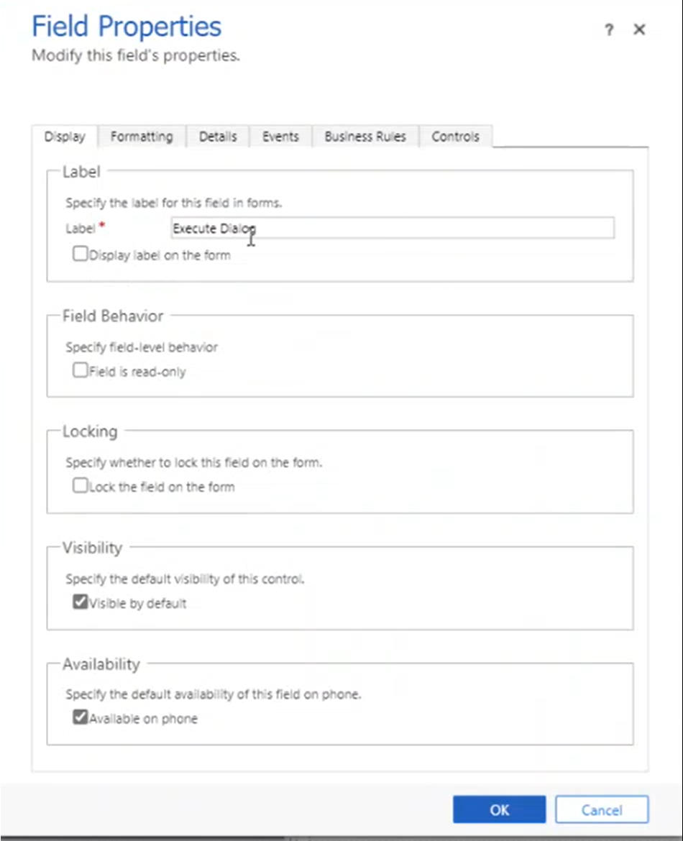
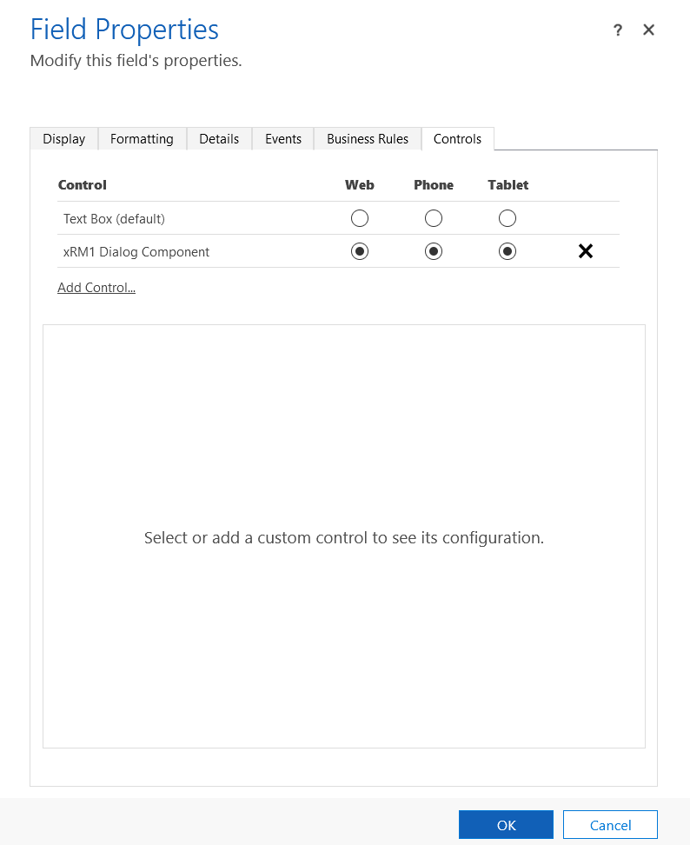
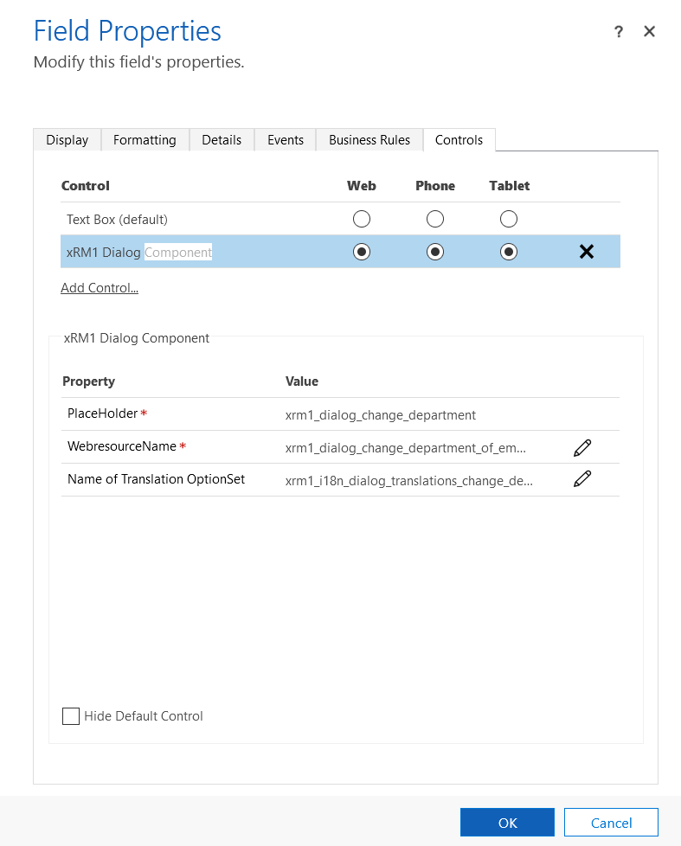
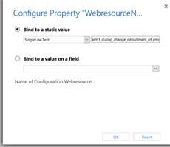
How to add a dialog button
Double click the new field to open the settings
Uncheck “ Display label
Go to controls and add xRM1 Dialog Component select the option for Web/Phone/Tablet
Edit the dialog component by double click it.
Edit Webresource Name and OptionSet with according terms form the list (next page)
2
4
1
3
5
6

Slide 4
Copy and Paste from this list
Name of the dialog button | Property Type | WebressourceName | Name of Translation OptionSet
Modify Leave Request | Single Line Of Text Field | xrm1_dialog_modify_leave_request.json | xrm1_i18n_dialog_translations_modify_leave_request
Add Leave Entitlement | Single Line Of Text Field | xrm1_dialog_leave_entitlement_add_new.json | xrm1_i18n_dialog_translations_add_leave_entitlement
Replace Active Employment Term | Single Line Of Text Field | xrm1_dialog_replace_active_employment_terms.json | xrm1_i18n_dialog_translations_replace_active_employment_terms
Change Department (of Employee) | Single Line Of Text Field | xrm1_dialog_change_department_of_employee.json | xrm1_i18n_dialog_translations_change_department
Copy Wages | View | xrm1_dialog_copy_wages.json | xrm1_i18n_dialog_translations_copy_wages
Generate Payments | View | xrm1_dialog_create_payments.json | xrm1_i18n_dialog_translations_create_payments
Parse CV | Single Line Of Text Field | xrm1_dialog_cv_parsing.json | xrm1_i18n_dialog_translations_cv_parsing
Extend Wage | Single Line Of Text Field | xrm1_dialog_extend_wage.json | xrm1_i18n_dialog_translations_extend_wage
XING Integration Authentication | Single Line Of Text Field | xrm1_dialog_xing_integration_authorization.json | xrm1_i18n_dialog_translations_xing_integration_authorization
Onboarding - Offboarding | Single Line Of Text Field | xrm1_dialog_onboarding_template.json | xrm1_i18n_dialog_translations_on_off_boarding_template
Recalculate Leave Entities | Single Line Of Text Field | xrm1_dialog_recalculate_leave_entites.json | xrm1_i18n_dialog_translations_recalc_leave
Recalculate Payment Summary | Single Line Of Text Field | xrm1_dialog_recalculate_payment_summary.json | xrm1_i18n_dialog_translations_recalculate_payment_summary
Set Employment Terms End Date | Single Line Of Text Field | xrm1_dialog_set_employment_terms_end_date.json | xrm1_i18n_dialog_translations_set_employment_terms_end_date
StepStone Integration Authentication | Single Line Of Text Field | xrm1_dialog_stepstone_integration_authorization.json | xrm1_i18n_dialog_translations_stepstone_integration_authorization
Rework Template (Project) | Single Line Of Text Field | xrm1_dialog_template_project_management.json | xrm1_i18n_dialog_translations_template_project_management
Upload License | View | xrm1_dialog_upload_license.json | xrm1_i18n_dialog_translations_upload_license

Slide 5
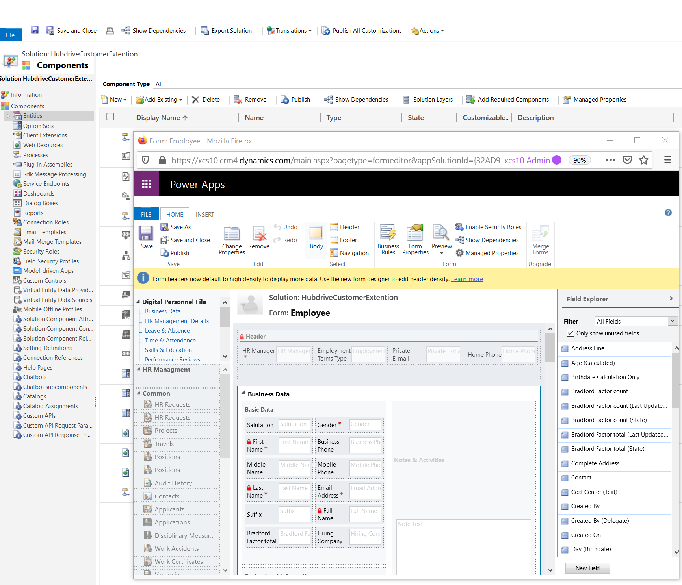
Almost finished
Click on ok to close the field settings.
Save and publish the form
Save and Publish the all customizations on the main page as well
4
5
2
3
1

